Slide 1
Placing labour markets in the evolution of old industrial regions: the case of Northern Rock
Stuart Dawley (Neill Marshall; Andy Pike, Jane Pollard and John Tomaney)
stuart.dawley@ncl.ac.uk
2012 LLAKES Conference: Lifelong Learning, Crisis and Social Change
19 October 2012
University of London

Slide 2
1. Introduction
Connect labour markets and skills to broader perspectives on the geographical evolution of economic landscapes
The case study of the rise and fall of Northern Rock in the North East of England
Can the qualitative structure of a labour market constrain or enable the nature of new growth paths within regional economies?
Refocus attention on the ‘demand-side’ of the labour market
Policy challenge: scale, scope and governance

Slide 3
2. Evolutionary approaches and labour markets
‘Evolutionary Turn’ in economic geography: ‘history matters’ based on notions of path dependency, creation and destruction
“The key research question is why some regions are capable of renewal and transformation while others are not” (Martin and Sunley 2006 p.419)
“….. arising from the specifics of their past economic development – the local environment may be less conducive to, perhaps even a ‘constraining’ force on, the emergence of new technologies and industries…” (Martin 2010 p.20)

Slide 4
2. Evolutionary approaches and labour markets
Source: Martin (2010)

Slide 5
2. Evolutionary approaches and labour markets
How do region’s evolve?: how and what?
To date attention focuses upon, inter alia, institutions (hard and soft); R&D; firms (start-ups, spin-offs, diversification); technological fields; innovation systems etc.

Slide 6
2. Evolutionary approaches and labour markets
Labour markets seen as a relatively passive, even subordinate, factor shaping the evolution of localities and regions (Mackinnon et al 2009), but:
Spatial and corporate divisions of labour (Massey 1995)
Occupational ‘relatedness’?: enabling or constraining?
‘Occupational (Dis) Advantage’ (Markussen 2004)?
  What people do, rather than the products they generate
Skills-equilibriums (Finegold 2009; Green 2012) and ecosystems (Buchanan et al 2001)?
Dynamic inter-relations between demand and supply-side

Slide 7
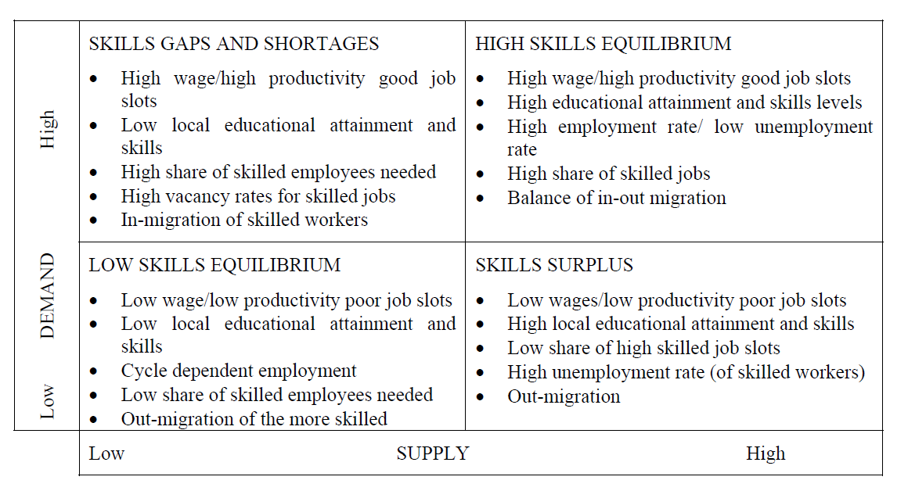
Regional Low Skills Equilibrium ?
Green, A. (2012), “Skills for Competitiveness: Country Report for United Kingdom”, OECD Local Economic and Employment Development (LEED) Working Papers, 2012/05, OECD Publishing.

Slide 8
The North East Labour Market Weakness: A Question of Demand ? (Stone and Braidford 2002)

Slide 9
3. Rise and fall of Northern Rock: continuity or change in an old industrial region ?

Slide 10
Phase 1: The Northern Rock ‘boom’ in North East England
Historically weak growth rates in the service sector, especially finance and business services
‘Public sector region’ and call centre boom
Reproduction and dependence of routine occupations
2000-2007 Employment Growth
  41% (49,000) increase in prof, financial and business services
  36% (6,436) increase in financial intermediation
A qualitative shift to a new path of growth in financial services?

Slide 11
Full-time equivalent employment in SIC2003 65: Financial intermediation, except insurance and pension funding, 1998 to 2008, by sub-region
Source: Annual Business Inquiry Employee Analysis (from Nomis on
22 June 2011) ONS Crown Copyright Reserved

Slide 12
Employment trends (indexed to 1999) for full-time Equivalent Employment in SIC2003 65: Financial intermediation, except insurance and pension funding
Source: Annual Business Inquiry Employee Analysis (from Nomis on 22 June 2011)
ONS Crown Copyright Reserved

Slide 13
Northern Rock as the flagship of growth
“If you had been asked in the spring of 2007 to nominate one company that summed up Britain’s successful transformation from a manufacturing to a service economy, Northern Rock would have been a reasonable choice…it became an IT-enabled finance house, filling the vacuum left by that region’s industrial decline and offering well-paid jobs in modern air-conditioned offices to 6,000 employees. These children and grandchildren of miners and shipyard workers had learned new skills as members of Britain’s financial services army, an industry at the cutting edge of the country's new knowledge economy” (Augar 2009: 149).
Source: Augar, P. (2009) Chasing Alpha, Bodley Head: London

Slide 14
Historically rooted building society and regional employer
1997 demutualisation: connects to wider markets of financialistion and the ‘originate and distribute’ mortgage model
Rapid growth 2000-2006
  3,000 jobs created in NE
  90% of Northern Rock’s workforce in NE
  50% of all financial intermediation jobs created in NE
Source: 2000-05 taken from annual report and accounts; 2006-08 data
provided by Northern Rock; all data are annual averages, with the
exception of 2008 which is the November headcount and 2009 which
is the June headcount.

Slide 15
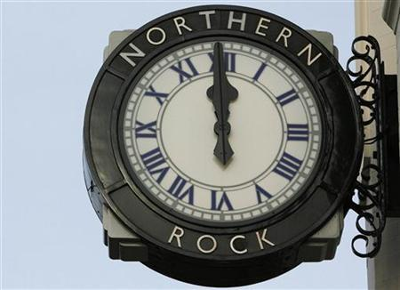
Business model as manufacturer of mortgages: reinforces low-skill equilibrium (cost > quality)
“Northern Rock is the lowest cost producer in the banking industry in Europe. A key advantage over rivals is that its head office and key operational units are located in the North East of England where wages are, on average, lower than in the rest of the UK. The cost of living is much lower in this area, so people are able to enjoy a high standard of living even though income may be lower. Northern Rock is then able to pass this advantage of low costs to its customers”
http://companyinfo.northernrock.co.uk/downloads/results/NorthernRockFinalV2.pdf

Slide 16
Employment by grade of staff
2004: 1/3 staff in call centres (telesales; data processing)
2007: 54% of workforce occupied clerical grades
Source: Regeneris et al 2009

Slide 17
Mid 2000s: staff turnover at 10-15% p.a.
Salaries: ‘bottom quartile’ to ‘middle rung for the region’ (NR HR Manager, Author’s Interview 2008)
Limited growth in higher skilled financial service work (e.g. treasury; audit etc)
Old wine in new bottles? Northern Rock’s growth model was, in part, shaped by the region’s occupational structure and historical role in spatial divisions of labour

Slide 18

Phase 2: ‘Boom to bust’… Restructuring the Rock
2007 ‘Run on the Rock’; Nationalisation and Restructuring

Slide 19
Phase 2: ‘Boom to bust’… Restructuring the Rock
2007-10: 2,800 jobs lost (3,500 by 2011)
2007–2009:
  1 in 3 of NR’s North East workforce cut
  Wiped out 1/3 of the job growth witnessed in the region’s financial intermediation sector 2000-2007
NR job losses concentrated in the functions and occupations which grew during the ‘bubble’

Slide 20
Northern Rock Redundancies by Business Function and Grade
Business Function | % of Redundancies | Occupational Grade | % of Redundancies
Mortgage Operations | 37 | General Clerical | 52
Sales | 32 | Lower/Middle Management | 16
Information Technology | 13 | Technical | 9
Training | 6 | Sales Management | 9
Debt Management | 2 | Technical Management | 4
Savings | 2 | Clerical Sales | 3
Human Resources | 2 | Head Office Sales | 3
Customer Services | 2 | Senior Management | 3
Executives | 1 | Other | 1
Others | 3
Total | 100% | Total | 100%
Source: Regeneris et al 2009

Slide 21
Phase 3: Resettlement
Limited absorptive capacity? : recession, rising unemployment, especially in financial services
Northern Rock Skills Tracking Study (NRSTS)
  Survey waves at 3, 6, 12 months
  88% of redundant workforce within our target population
  612 engaged in the survey
  At 12 months: 322 respondents (29%)
  25 semi-structured interviews

Slide 22
Employment status of redundant workers
 | Wave 1 December 2008 |  | Wave 3 July/August 2009
 | No. | % | No. | %
Unemployed | 226 | 49 | 83 | 26
In employment | 154 | 33 | 184 | 57
Self employed | 11 | 3 | 12 | 4
In training / education | 21 | 4 | 15 | 5
Taking a career break | 26 | 5 | 5 | 1
Unable to work (sickness/incapacity) | 13 | 3 | 0 | 0
Retired | 15 | 3 | 24 | 7
Total | 466 | 100 | 323 | 100
Source: Confidential

Slide 23
Phase 3: Resettlement
By volume, General Sales, General clerical and Customers Services grades dominate both employed (60%) and unemployed (31%)
Proportionally, General Sales, Clerical and Customer Services (68%; 92) more likely to be employed than former Management (55%; 47)
Highest rates of employment at ‘intermediate level’ qualifications (A-Level; HNC/HND; NVQ 1&2)
Only 1 in 2 with Degree level qualifications found work
Supply-side differentiation but key role of regional ‘demand’

Slide 24
Occupational Continuity
“ [T]o be perfectly honest I think our redundant staff complemented firms operating in shared services and call centre activities, such as Orange, Sage, Convergis, Fusion. The companies that we been working with to resettle the workers are mostly looking for sales, customers service advisors or telephone skills” (Northern Rock HR Manager, Authors’ Interview, 2008).
Administrative and Secretarial (34%) Sales and Customer Services (23%)
Public sector: calls centres, data processing and administration
Only 13% claimed to have found employment through NR Response Group

Slide 25
Sectoral Change
1 digit SIC | No. of respondents | % of respondents
N. Health and Social Work | 47 | 27%
J. Financial Intermediation | 24 | 14%
L.. Public Administration and defence; compulsory social security | 23 | 13%
K. Real Estate, Renting and Business Activities | 21 | 12%
G. Wholesale and Retail Trade, Repair of Motor Vehicles and Motorcycles | 17 | 10%
88% of which earned £15-24,999 at Northern Rock

Slide 26
Rise and fall of Northern Rock: continuity or change in an old industrial region ?
New path of growth, albeit enabled and constrained by the North East’s established position as a low cost region for routine clerical labour
Raises the possibility of ‘occupational disadvantage’, limiting the adaptive capacity to diversify or upgrade into qualitatively different paths of growth and employment
Relatively successful resettlement patterns:
  ‘Absorptive capacity’ via occupational relatedness, continuity and sectoral change
  Confirms the NR bubble was ‘related’ to intermediate and low skilled functions than higher-skilled financial services
  Low-road form of regional resilience and adaptive capacity?

Slide 27
Conclusions
Skills agenda integral to broader notions of economic development and evolution
Labour markets shape, and are shaped by, the emergence, development and character of new paths of growth:
  Semiconductors ‘v’ Offshore wind
Policy challenge:
A ‘demand side’ problem?: (re) integration of strategic economic policy and skills
Structural upgrade: New activities, but with ‘related variety’ (Boschma 2009) to pull through existing assets and contexts
Latent development: skills utilisation (Payne 2011)
Governance: RDAs to LEPs

Slide 28
Placing labour markets in the evolution of old industrial regions: the case of Northern Rock
Stuart Dawley (Neill Marshall; Andy Pike, Jane Pollard and John Tomaney)
stuart.dawley@ncl.ac.uk
2012 LLAKES Conference: Lifelong Learning, Crisis and Social Change
19 October 2012
University of London

