Slide 1
The OECD Skills Strategy Better Skills, Better Jobs, Better Lives 2012 LLAKES Conference Lifelong Learning, Crisis and Social Change Thursday 18 October to Friday 19 October 2012
Glenda Quintini Senior Economist - Employment Analysis And Policy Division Directorare For Employment Labour And Social Affairs At OECD

Slide 2
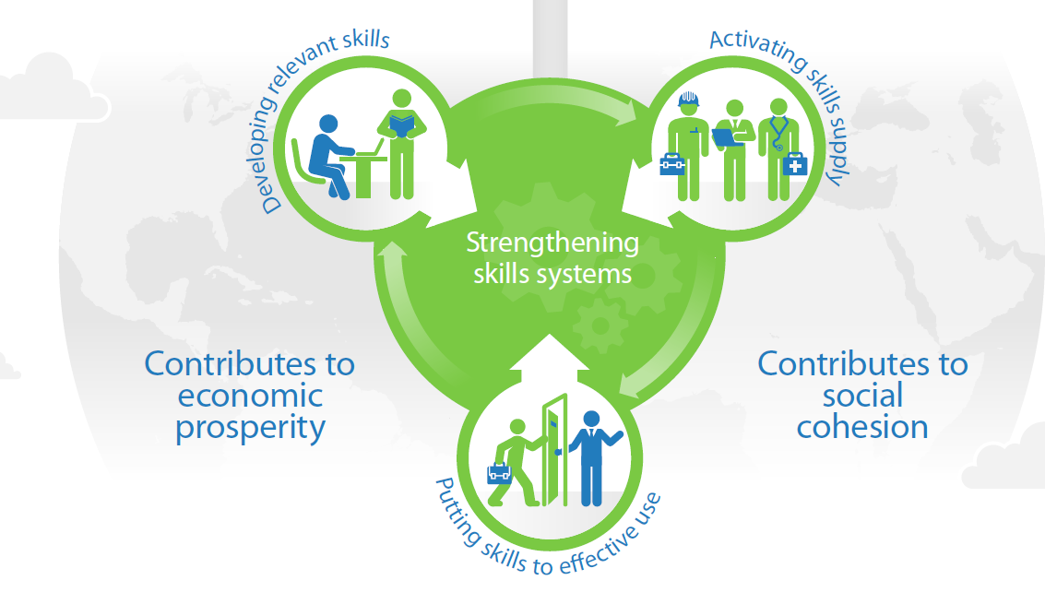
Why skills matter

Slide 3
Skills matter…
…because they have an increasing impact on economic outcomes and social participation

Slide 4
Low skills and economic outcomes
*Odds are adjusted for age, gender and immigration status.

Slide 5
...but qualifications are not the same as skills...
…because we continue to learn after obtaining a degree
…and because we lose skills that we do not use

Slide 6
Measuring the value of qualifications Interquartile range in skill distribution by educational qualification
Notes:
I mentioned that formal qualifications cannot be equated with actual skills. Let me illustrate this point with a chart that shows the distribution of skills for people with different educational qualifications.
Lets pick one country. First you see that adults who didn’t complete secondary schooling demonstrate a range of skills, the orange bar represents the middle half of the skill distribution. So not everyone who is a high-school dropout is unskilled. As you would expect people with a high school degree tend to do better, but you see that there is significant overlap. And those who have a university degree come out on top.
The picture is not that clear in all countries. Take another country. Here the performance of adults with school and university qualifications is rather similar.
The picture gets most interesting when you contrast one country with another. Take a third country here. You see that high school graduates in the second country are about as highly skilled as the university graduates in the third.
That illustrates the power of the OECD Adult Skills Survey in benchmarking the value of national academic and vocational qualifications across countries, something we have never been able to do before.

Slide 7
The OECD Skills Strategy

Slide 8
How does a country maximise its skills?
Developing the right skills
By encouraging and enabling people to learn throughout life
Gather and use evidence about changing skills demand to guide skills development
Engage social partners in designing and delivering education and training programmes
Ensure that education and training programmes are of high quality
Promote equity by ensuring access to, and success in, quality education for all
Ensure that costs are shared and that tax systems do not discourage investments in learning
Maintain a long-term perspective on skills development, even during economic crises
By fostering international mobility of skilled people to fill skills gaps
Facilitate entry for skilled migrants and support their integration
Design policies that encourage international students to remain after their studies
Make it easier for skilled migrants to return to their country of origin
By promoting cross-border skills policies
Invest in skills abroad and encourage cross-border higher education

Slide 9
Keeping learning beyond school Cross-sectional skill-age profiles for youths by education and work status
Youth in education and work
Youth in education
Youth in work
Not in education, not in work

Slide 10
Unused skills may be more likely to atrophy

Slide 11
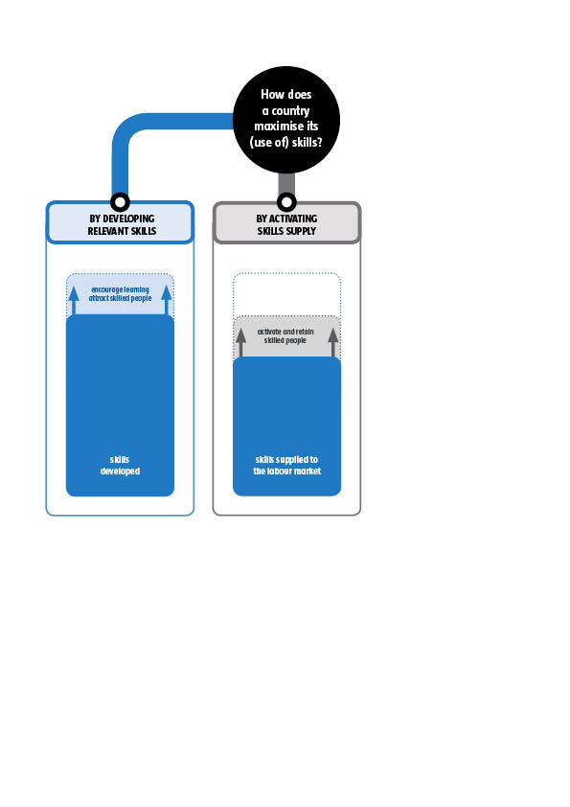
The OECD Skills Strategy

Slide 12
How does a country maximise its skills?
Activate the supply of skills
By encouraging people to offer their skills to the labour market
Identify inactive individuals and the reasons for their inactivity
Create financial incentives that make work pay
Dismantle non-financial barriers to participation in the labour force
By retaining skilled people in the labour market
Discourage early retirement
Staunch brain drain

Slide 13
Labour force participation varies Percentage of 25-64-year-olds active in the labour market, 2011

Slide 14
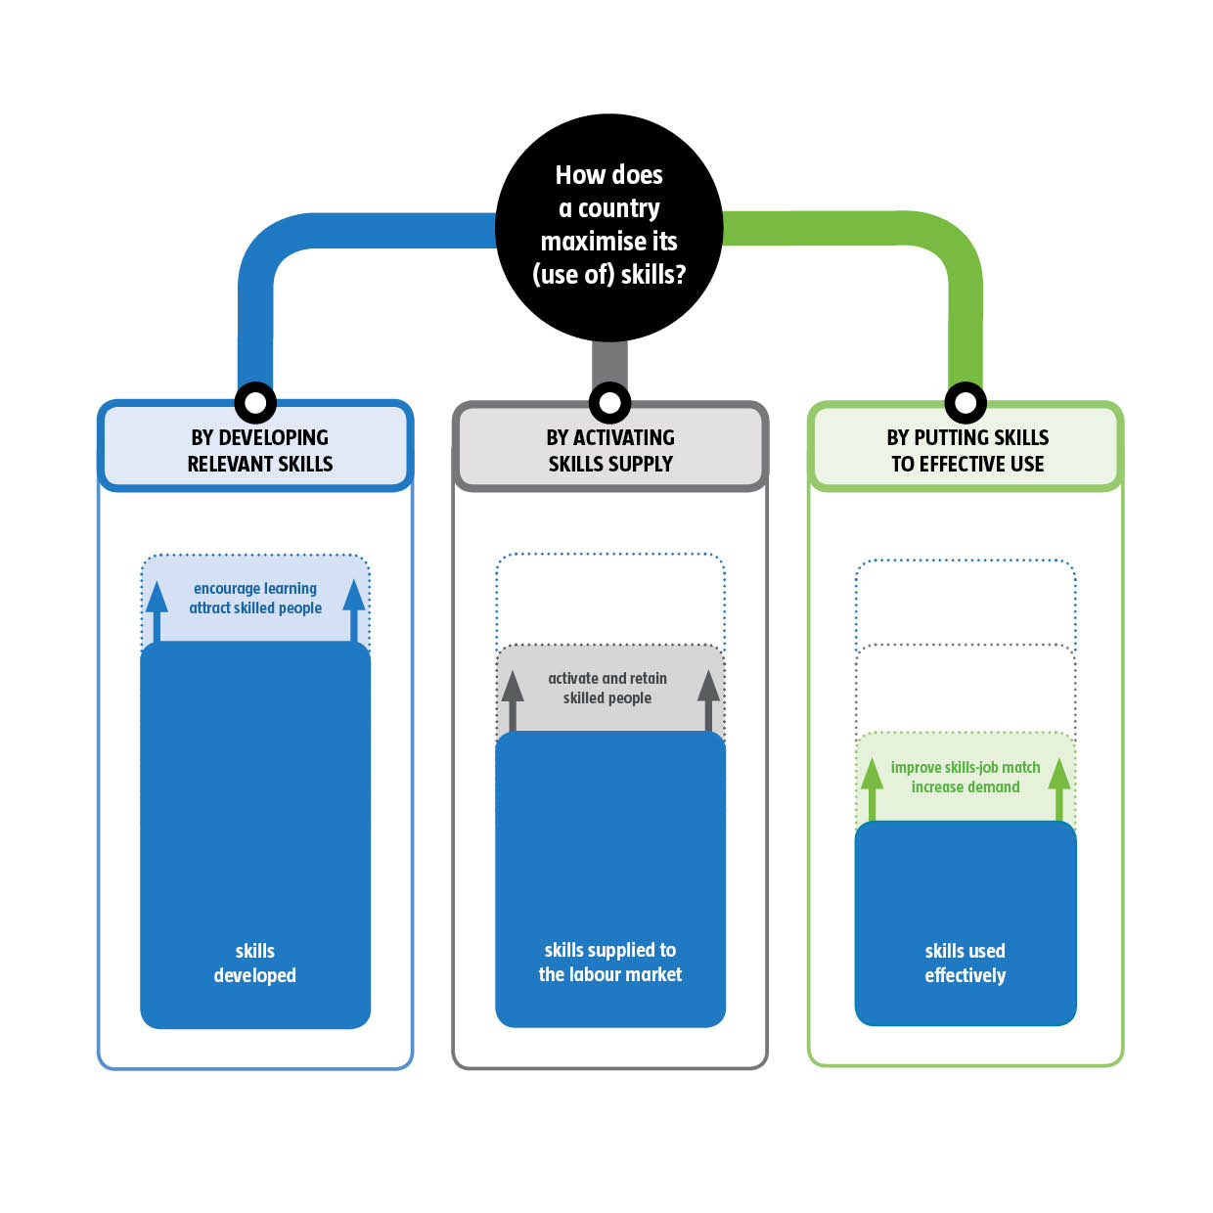
The OECD Skills Strategy

Slide 15
How does a country maximise its skills?
Put skills to effective use
By creating a better match between people’s skills and the requirements of their job
Help employers to make better use of their employees’ skills
Tackle unemployment and help young people to gain a foothold in the labour market
Provide better information about the skills needed and available
Facilitate mobility among local labour markets
By increasing the demand for high-level skills
Help economies to move up the value-added chain
Stimulate the creation of more high-skilled and high value-added jobs
Foster entrepreneurship

Slide 16
Evidence on the link between skill mismatch and earnings
Skill mismatch and earnings are strongly related

Slide 17
Follow up
Skills Outlook:
2013 – First International Report of the OECD Survey of Adult Skills (PIAAC)
24 countries
Direct assessment, Job Requirements module, background questionnaire
Publication of first results: October 2013
2014+ Showcasing horizontal work on skills
Projects on: “Anticipating Skill Needs” and “National Skills Strategies”

Slide 18
THANK YOU

